Slide 1
Big Data Programming
Spark Programming
Transformations and Actions
Notes:
Apache Spark is a fast, in-memory data processing engine with elegant and expressive development APIs to allow data workers to efficiently execute streaming, machine learning or SQL workloads that require fast iterative access to datasets.

Slide 2
Ways to use spark
Spark Local Installation (Explained in first section of this ppt)
Running spark in IntelliJ (Recommended for ICP)
Running spark in PyCharm
Notes:
Apache Spark is a fast, in-memory data processing engine with elegant and expressive development APIs to allow data workers to efficiently execute streaming, machine learning or SQL workloads that require fast iterative access to datasets.

Slide 3
Installation of spark locally

Slide 4
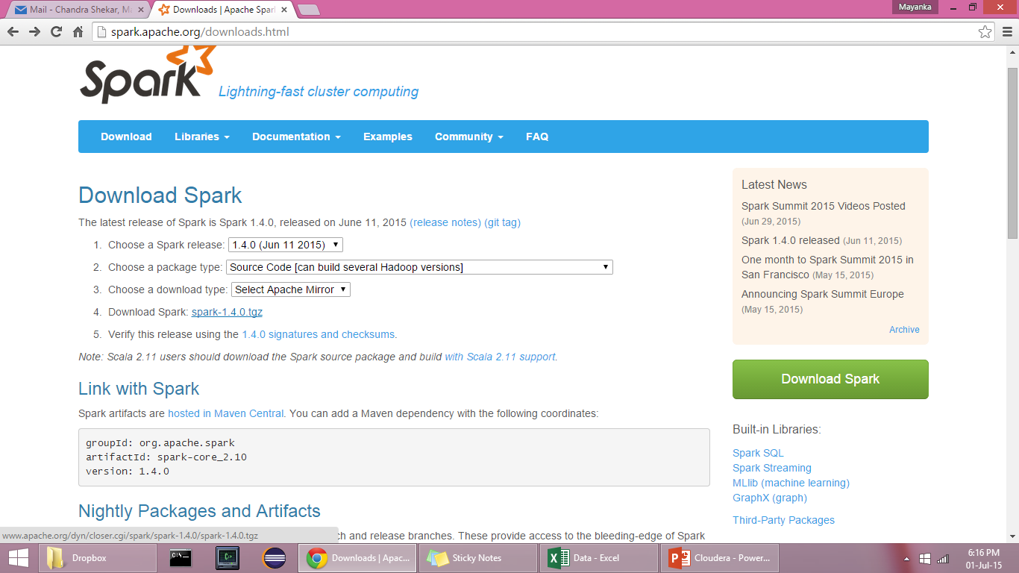
Install Apache Spark Locally
http://spark.apache.org/downloads.html

Slide 5
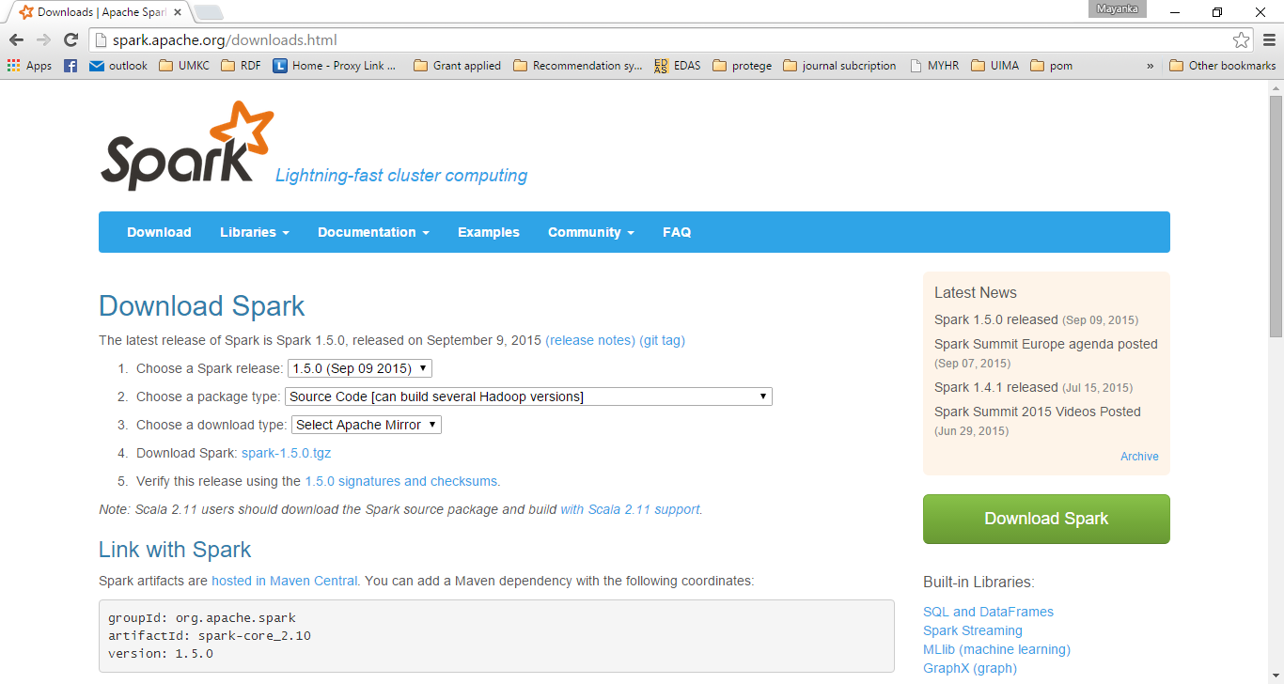

Slide 6
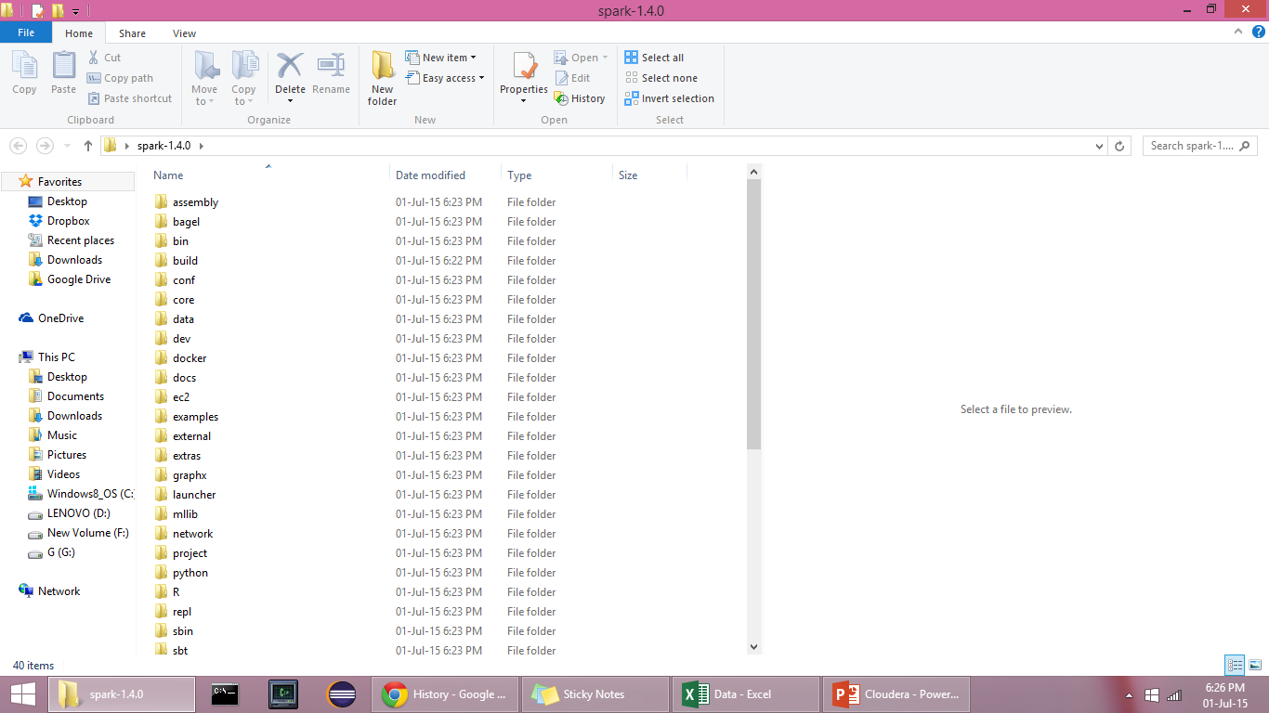
spark-1.5.0.tgz will be downloaded
Use Winrar or some tool to extract the archived file on to the destination folder.

Slide 7
Building Spark
Now go to the root folder of spark using terminal/Command Prompt
Go to Git Bash.
To the spark folder and run the following command.
bulid/sbt clean assembly.
It takes a while to build spark

Slide 8
Starting Spark
Use the terminal to run spark-shell.
Go to spark1.5.0/bin folder.
Run the following command
spark-shell : spark-shell command opens a scala terminal
You can use this terminal, to type scala commands to execute

Slide 9
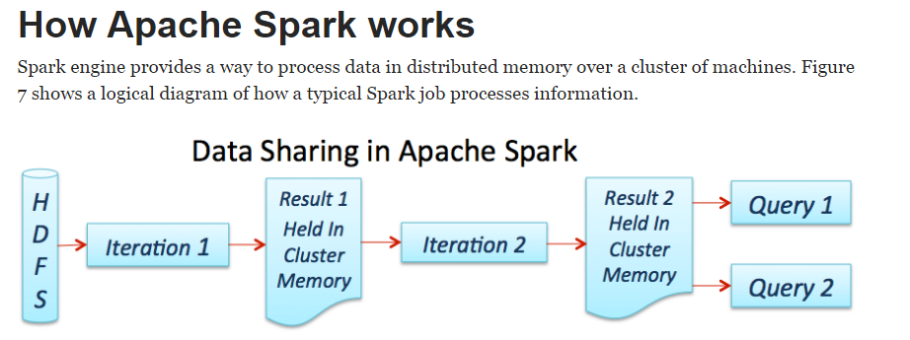
Source: https://dzone.com/refcardz/apache-spark

Slide 10
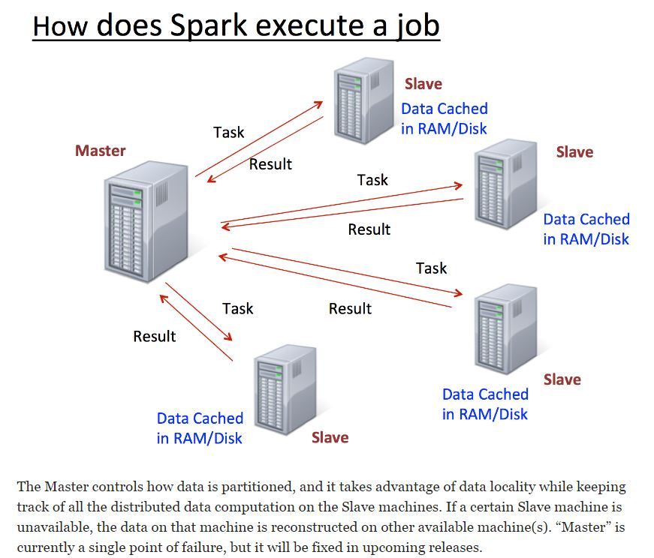
Source: https://dzone.com/refcardz/apache-spark

Slide 11
Learning Spark Programming
Easiest way: Spark interpreter (spark-shell or pyspark)
Special Scala and Python consoles for cluster use
Runs in local mode on 1 thread by default, but can control with MASTER environment var:
MASTER=local ./spark-shell # local, 1 thread MASTER=local[2] ./spark-shell # local, 2 threads MASTER=spark://host:port ./spark-shell # Spark standalone cluster

Slide 12
First Stop: SparkContext
Main entry point to Spark functionality
Created for you in Spark shells as variable sc
In standalone programs, you’d make your own (see later for details)
Notes:
SparkContext (aka Spark context) is the entry point to the Spark services for a Spark application. Spark context sets up internal services and establishes a connection to a Spark execution environment. You could also assume that a SparkContext instance is a Spark application. A Spark context is essentially a client of Spark’s execution environment and acts as the master of your Spark application (don’t get confused with the other meaning of Master in Spark, though). Once a SparkContext is created you can use it to create RDDs, accumulators and broadcast variables, access Spark services and run jobs (until SparkContext is stopped).

Slide 13
Creating RDDs
# Turn a local collection into an RDD
sc.parallelize([1, 2, 3]) #Python
sc.parallelize(Array(1, 2, 3)) #Scala
# Load text file from local FS, HDFS, or S3
sc.textFile(“file.txt”)
sc.textFile(“directory/*.txt”)
sc.textFile(“hdfs://namenode:9000/path/file”)
# Use any existing Hadoop InputFormat
sc.hadoopFile(keyClass, valClass, inputFmt, conf)
Notes:
The main abstraction Spark provides is a resilient distributed dataset (RDD), which is a collection of elements partitioned across the nodes of the cluster that can be operated on in parallel. RDDs are created by starting with a file in the Hadoop file system (or any other Hadoop-supported file system), or an existing Scala collection in the driver program, and transforming it. Users may also ask Spark to persist an RDD in memory, allowing it to be reused efficiently across parallel operations. Finally, RDDs automatically recover from node failures. Spark revolves around the concept of a resilient distributed dataset (RDD), which is a fault-tolerant collection of elements that can be operated on in parallel. There are two ways to create RDDs: parallelizing an existing collection in your driver program, or referencing a dataset in an external storage system, such as a shared filesystem, HDFS, HBase, or any data source offering a Hadoop InputFormat. At a high level, every Spark application consists of a driver program that runs the user’s main function and executes various parallel operations on a cluster.

Slide 14
Basic Transformations (Python)
nums = sc.parallelize([1, 2, 3])
# Pass each element through a function
squares = nums.map(lambda x: x*x) # => {1, 4, 9}
# Keep elements passing a predicate
even = squares.filter(lambda x: x % 2 == 0) # => {4}
# Map each element to zero or more others
nums.flatMap(lambda x: range(0, x)) # => {0, 0, 1, 0, 1, 2}
Range object (sequence of numbers 0, 1, …, x-1)
Notes:
RDDs support two types of operations: transformations, which create a new dataset from an existing one, and actions, which return a value to the driver program after running a computation on the dataset. ****All transformations in Spark are lazy, in that they do not compute their results right away. Instead, they just remember the transformations applied to some base dataset (e.g. a file). The transformations are only computed when an action requires a result to be returned to the driver program.
Python supports the creation of anonymous functions (i.e. functions that are not bound to a name) at runtime, using a construct called "lambda". This is not exactly the same as lambda in functional programming languages, but it is a very powerful concept that's well integrated into Python and is often used in conjunction with typical functional concepts like filter(), map() and reduce(). lambda definition does not include a "return" statement -- it always contains an expression which is returned. Also note that you can put a lambda definition anywhere a function is expected, and you don't have to assign it to a variable at all.

Slide 15
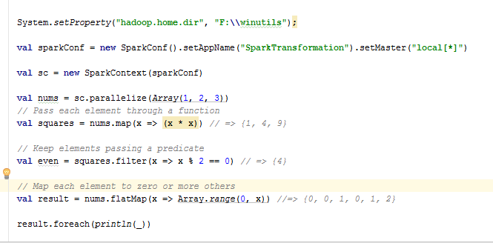
Basic Transformations (Scala)
Notes:
Anonymous function syntax in scala

Slide 16
Basic Actions (Python)
Note:
Collect() and count() throws the Py4JavaError, to use take() or saveAsTextFile() in it's place
Reduce() and sortbyKey() might throw the same error.
nums = sc.parallelize([1, 2, 3])
# Retrieve RDD contents as a local collection nums.collect() # => [1, 2, 3]
# Return first K elements nums.take(2) # => [1, 2]
# Count number of elements nums.count() # => 3
# Merge elements with an associative function nums.reduce(lambda x, y: x + y) # => 6
# Write elements to a text file nums.saveAsTextFile(“hdfs://file.txt”)
Notes:
Launch computations. collect(): Return all the elements of the dataset as an array at the driver program. This is usually useful after a filter or other operation that returns a sufficiently small subset of the data.

Slide 17
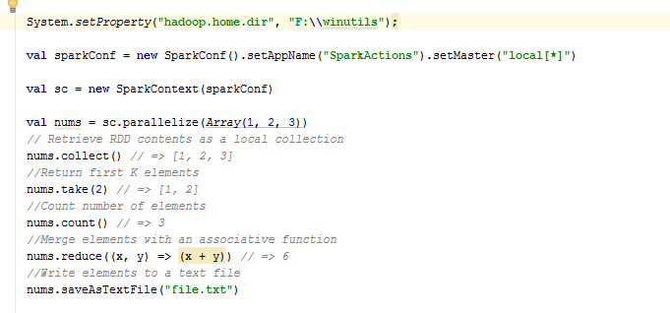
Basic Actions (Scala)

Slide 18
Working with Key-Value Pairs
Spark’s “distributed reduce” transformations act on RDDs of key-value pairs
Python: pair = (a, b)
pair[0] # => a
pair[1] # => b
Scala: val pair = (a, b)
pair._1 // => a
pair._2 // => b
Java: Tuple2 pair = new Tuple2(a, b); // class scala.Tuple2
pair._1 // => a
pair._2 // => b
Notes:
While most Spark operations work on RDDs containing any type of objects, a few special operations are only available on RDDs of key-value pairs. The most common ones are distributed “shuffle” operations, such as grouping or aggregating the elements by a key.

Slide 19
Some Key-Value Operations (Python)
pets = sc.parallelize([(“cat”, 1), (“dog”, 1), (“cat”, 2)])
pets.reduceByKey(lambda x, y: x + y) # => {(cat, 3), (dog, 1)}
pets.groupByKey() # => {(cat, Seq(1, 2)), (dog, Seq(1)}
pets.sortByKey() # => {(cat, 1), (cat, 2), (dog, 1)}
reduceByKey also automatically implements combiners on the map side

Slide 20
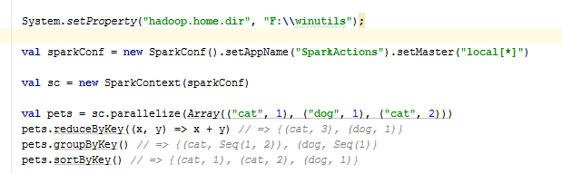
Some Key-Value Operations (Scala)

Slide 21
Example: Word Count (Python)
lines = sc.textFile(“hamlet.txt”)
counts = lines.flatMap(lambda line: line.split(“ ”)) \ .map(lambda word: (word, 1)) \ .reduceByKey(lambda x, y: x + y)
“to” “be” “or”
(to, 1) (be, 1) (or, 1)
(be, 2) (not, 1)
“to be or”
“not” “to” “be”
(not, 1) (to, 1) (be, 1)
(or, 1)
(to, 2)
“not to be”

Slide 22
Multiple Datasets (Python)
visits = sc.parallelize([(“index.html”, “1.2.3.4”), (“about.html”, “3.4.5.6”), (“index.html”, “1.3.3.1”)])
pageNames = sc.parallelize([(“index.html”, “Home”), (“about.html”, “About”)])
visits.join(pageNames) # (“index.html”, (“1.2.3.4”, “Home”)) # (“index.html”, (“1.3.3.1”, “Home”)) # (“about.html”, (“3.4.5.6”, “About”))
visits.cogroup(pageNames) # (“index.html”, (Seq(“1.2.3.4”, “1.3.3.1”), Seq(“Home”))) # (“about.html”, (Seq(“3.4.5.6”), Seq(“About”)))
Notes:
join(otherDataset, [numTasks]): When called on datasets of type (K, V) and (K, W), returns a dataset of (K, (V, W)) pairs with all pairs of elements for each key. Outer joins are supported through leftOuterJoin, rightOuterJoin, and fullOuterJoin.
cogroup(otherDataset, [numTasks]): When called on datasets of type (K, V) and (K, W), returns a dataset of (K, (Iterable<V>, Iterable<W>)) tuples. This operation is also called groupWith.

Slide 23
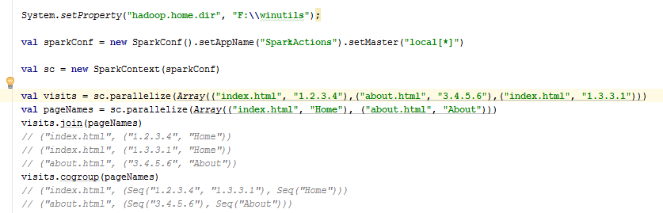
Multiple Datasets (Scala)

Slide 24
Controlling the Level of Parallelism
All the pair RDD operations take an optional second parameter for number of tasks
words.reduceByKey((x, y)=> x + y, 5)
words.groupByKey(5)
visits.join(pageViews, 5)

Slide 25
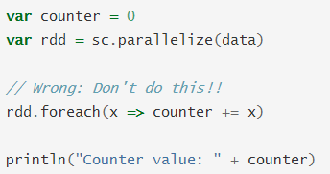
Using Local Variables
External variables you use in a closure will automatically be shipped to the cluster:
query = raw_input(“Enter a query:”)
pages.filter(lambda x: x.startswith(query)).count()
Some caveats:
Each task gets a new copy (updates aren’t sent back)
Variable must be Serializable (Java/Scala) or Pickle-able (Python)
Don’t use fields of an outer object (ships all of it!)
Notes:
Closure is a function that has an environment of its own. Inside this environment, there is at least one bound variable. One of the harder things about Spark is understanding the scope and life cycle of variables and methods when executing code across a cluster. RDD operations that modify variables outside of their scope can be a frequent source of confusion. To execute jobs, Spark breaks up the processing of RDD operations into tasks, each of which is executed by an executor. Prior to execution, Spark computes the task’s closure. The closure is those variables and methods which must be visible for the executor to perform its computations on the RDD. This closure is serialized and sent to each executor.
In general, closures - constructs like loops or locally defined methods, should not be used to mutate some global state. Spark does not define or guarantee the behavior of mutations to objects referenced from outside of closures. Some code that does this may work in local mode, but that’s just by accident and such code will not behave as expected in distributed mode. Use an Accumulator instead if some global aggregation is needed.

Slide 26
Closure Mishap Example
class MyCoolRddApp { val param = 3.14 val log = new Log(...) ... def work(rdd: RDD[Int]) { rdd.map(x => x + param) .reduce(...) } }
How to get around it:
class MyCoolRddApp { ... def work(rdd: RDD[Int]) { val param_ = param rdd.map(x => x + param_) .reduce(...) } }
NotSerializableException: MyCoolRddApp (or Log)
References only local variable instead of this.param

Slide 27
Spark – Inverted Index - Scala

Slide 28
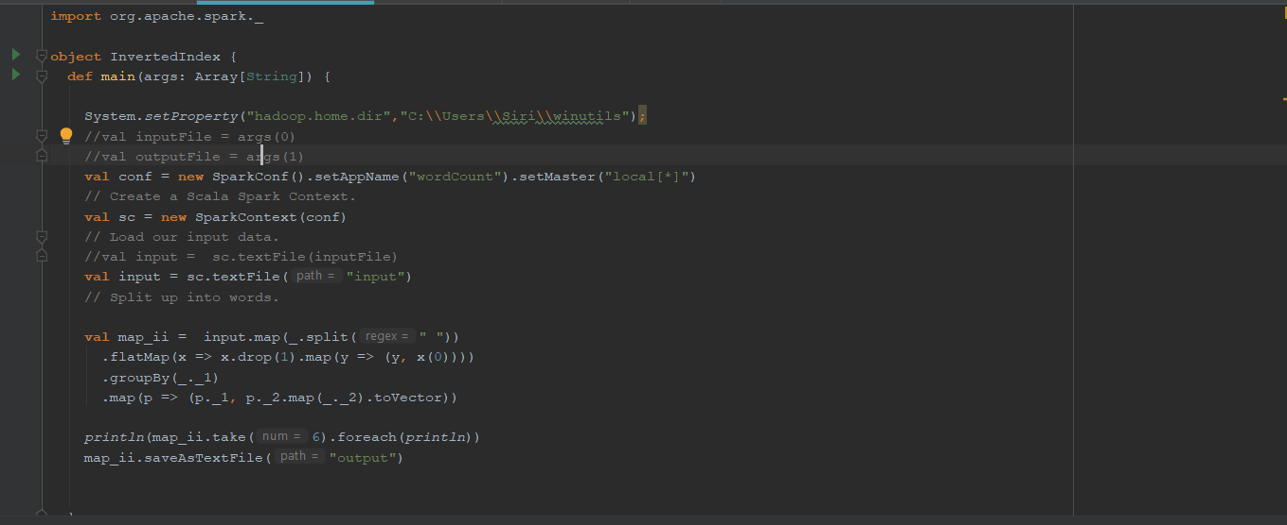
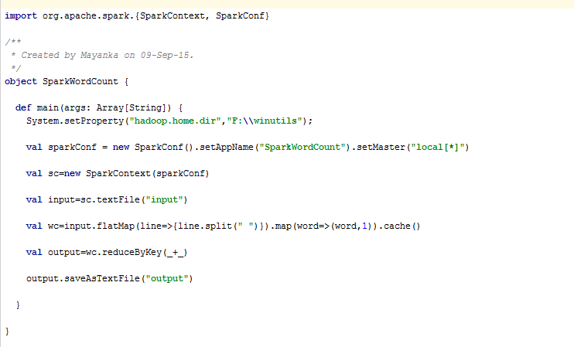
Spark – Inverted Index : Code Snippet

Slide 29
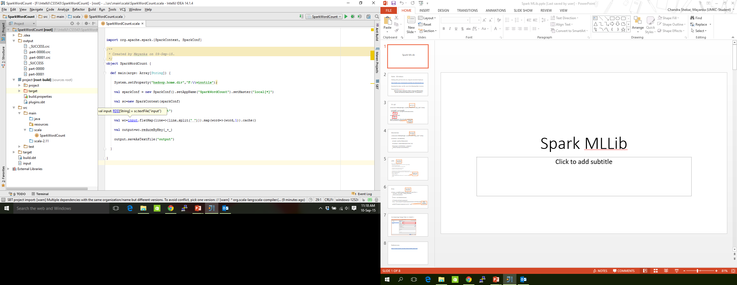
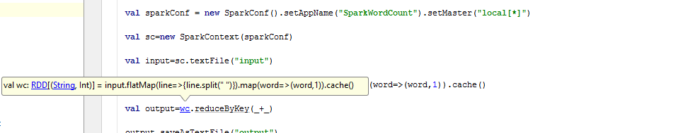
Spark FlatMap and Map Functions
Notes:
map transforms an RDD of length N into another RDD of length N. flatMap (loosely speaking) transforms an RDD of length N into a collection of N collections, then flattens these into a single RDD of results. Also, the output of flatMap is flattened . Though the function in flatMap returns a list of element(s) for each element but the output of FlatMap will be an RDD which has all the elements flattened to a single list.

Slide 30
Note : Windows
Hadoop_Home_Dir has to be set, a bug not corrected in Spark yet.
http://public-repo-1.hortonworks.com/hdp-win-alpha/winutils.exe
Download the above .exe file, save in the following folder structure
F:\winutils\bin\winutils.exe
Write the below statement, before using any Mlib function
System.setProperty("hadoop.home.dir","F:\\winutils");

Slide 31
Running Inverted Index in IntelliJ

Slide 32
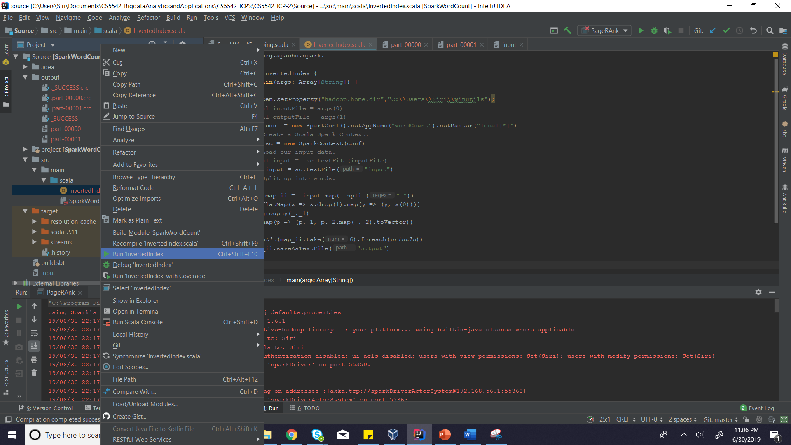
Run The Main Class

Slide 33
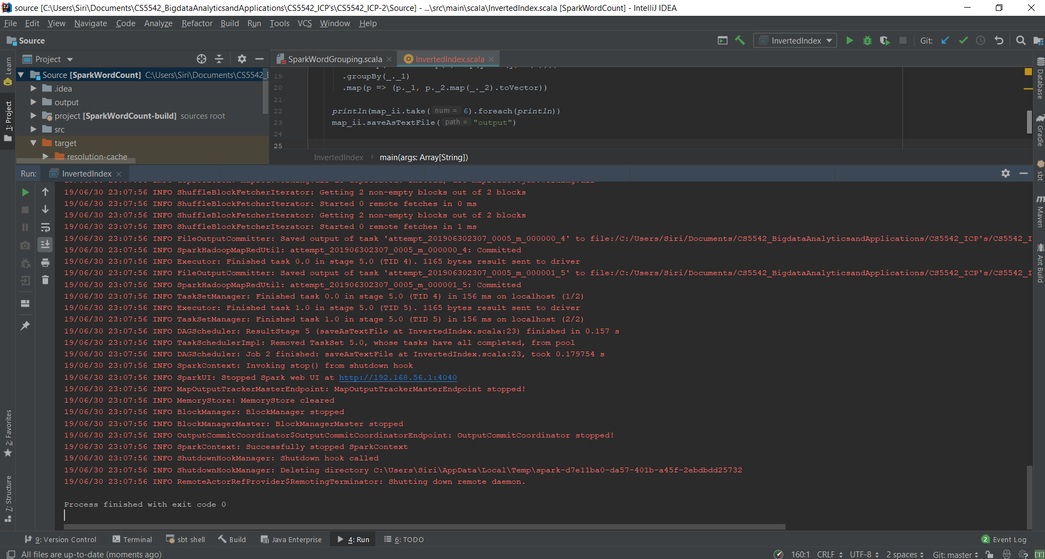

Slide 34
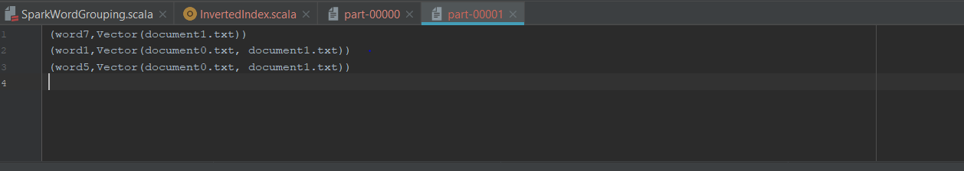
Output Folder

Slide 35
PyCharm + PySpark Installation
PySpark Installation Video: https://umkc.hosted.panopto.com/Panopto/Pages/Viewer.aspx?id=2ce7615d-78b1-466c-a432-a905015099dc
Pyspark Installation PPT: https://umkc.box.com/s/20prokaf1tza0pwltr714mvl9vzv0ji4

Slide 36
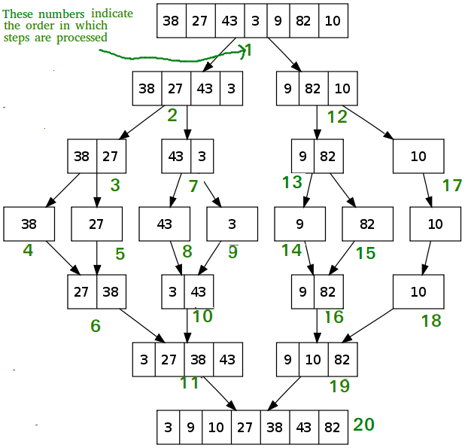
Merge Sort

Slide 37
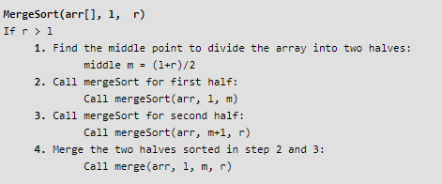
Pseudocode

Slide 38
Sortbykey
Sample stage: Sample the data to create a range-partitioner that will result in an even partitioning.
“Map” stage: Write the data to the destined shuffle bucket for reduce stage.
“Reduce” stage: Get the related shuffle output and merge/sort on the specific partition of dataset.

Slide 39
References
RDD A Fault Tolerance Abstraction
https://umkc.box.com/s/qv7iw89pzdafhg1308ztymx4qqe70awf
RDD ppt :
https://umkc.box.com/s/ujksg7hnkoz6yg5oxdqy0z5dp83fjbwp
Spark Cluster Computing
https://umkc.box.com/s/979ogyjq620nsltt6uq4o814rbhrjvd4
Merge Sort
https://www.geeksforgeeks.org/merge-sort/

Slide 40
Matrix Multiplication
https://spark.apache.org/docs/latest/mllib-data-types.html#blockmatrix
https://spark.apache.org/docs/latest/api/python/pyspark.mllib.html#pyspark.mllib.linalg.distributed.BlockMatrix
https://spark.apache.org/examples.html
Breadth First Search
http://www.theanalyticsuniverse.com/breadth-first-search-algorithm-bfs-in-apace-spark

Slide 41
Spark Programming References
https://spark.apache.org/docs/latest/rdd-programming-guide.html
https://www.tutorialspoint.com/apache_spark/advanced_spark_programming.htm
https://www.datacamp.com/community/tutorials/apache-spark-python
https://data-flair.training/blogs/spark-rdd-operations-transformations-actions/

Slide 42
More Details
Spark supports lots of other operations!
Full programming guide: spark-project.org/documentation

